Slide 1


Futbol va mashhur futbolchilar va ularning clublari

Slide 2

Man City

Slide 3

Real Madrid

Slide 4

Paris-Saint-German (PSG)

Slide 5

Arsenal

Slide 6

Chelsea

Slide 7

Liverpool

Slide 8
Inter

Slide 9

Milan

Slide 10

Tottenham

Slide 11

Juventus

Slide 12

Barcelona FC

Slide 13
Ering Haaland

Slide 14
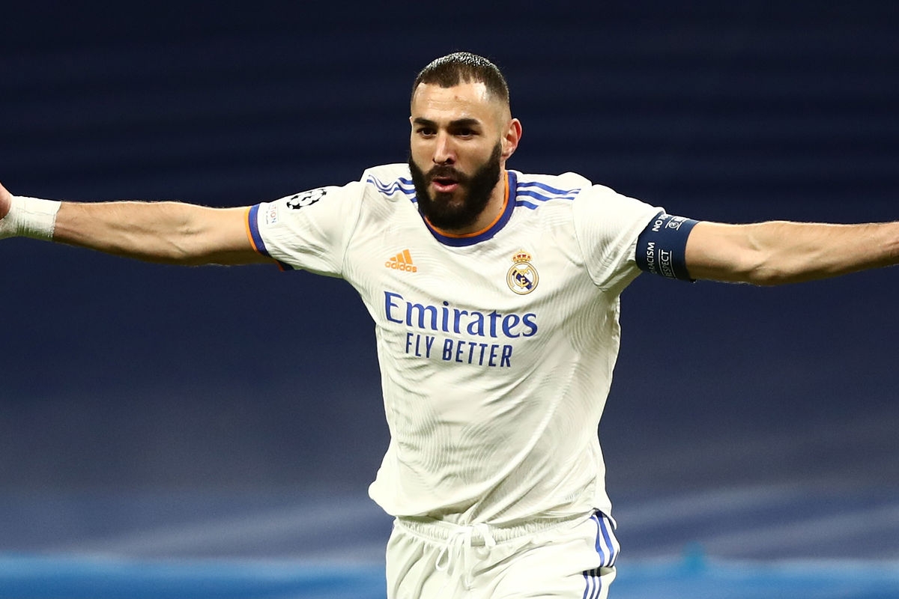
Karim Benzema

Slide 15
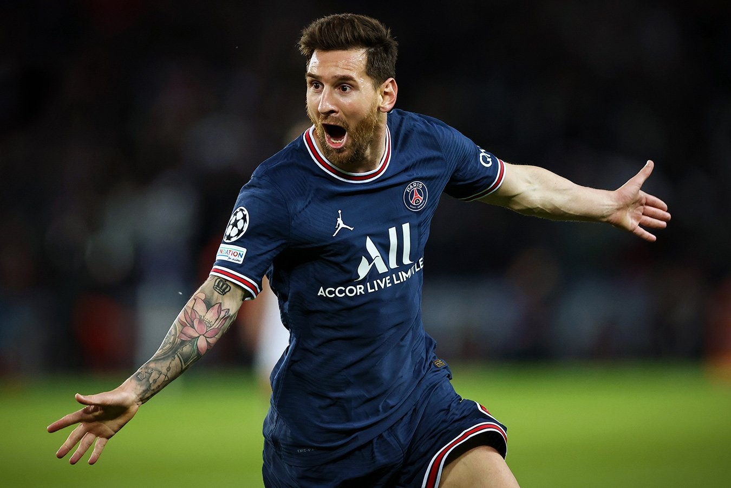
Leonel Messi

Slide 16
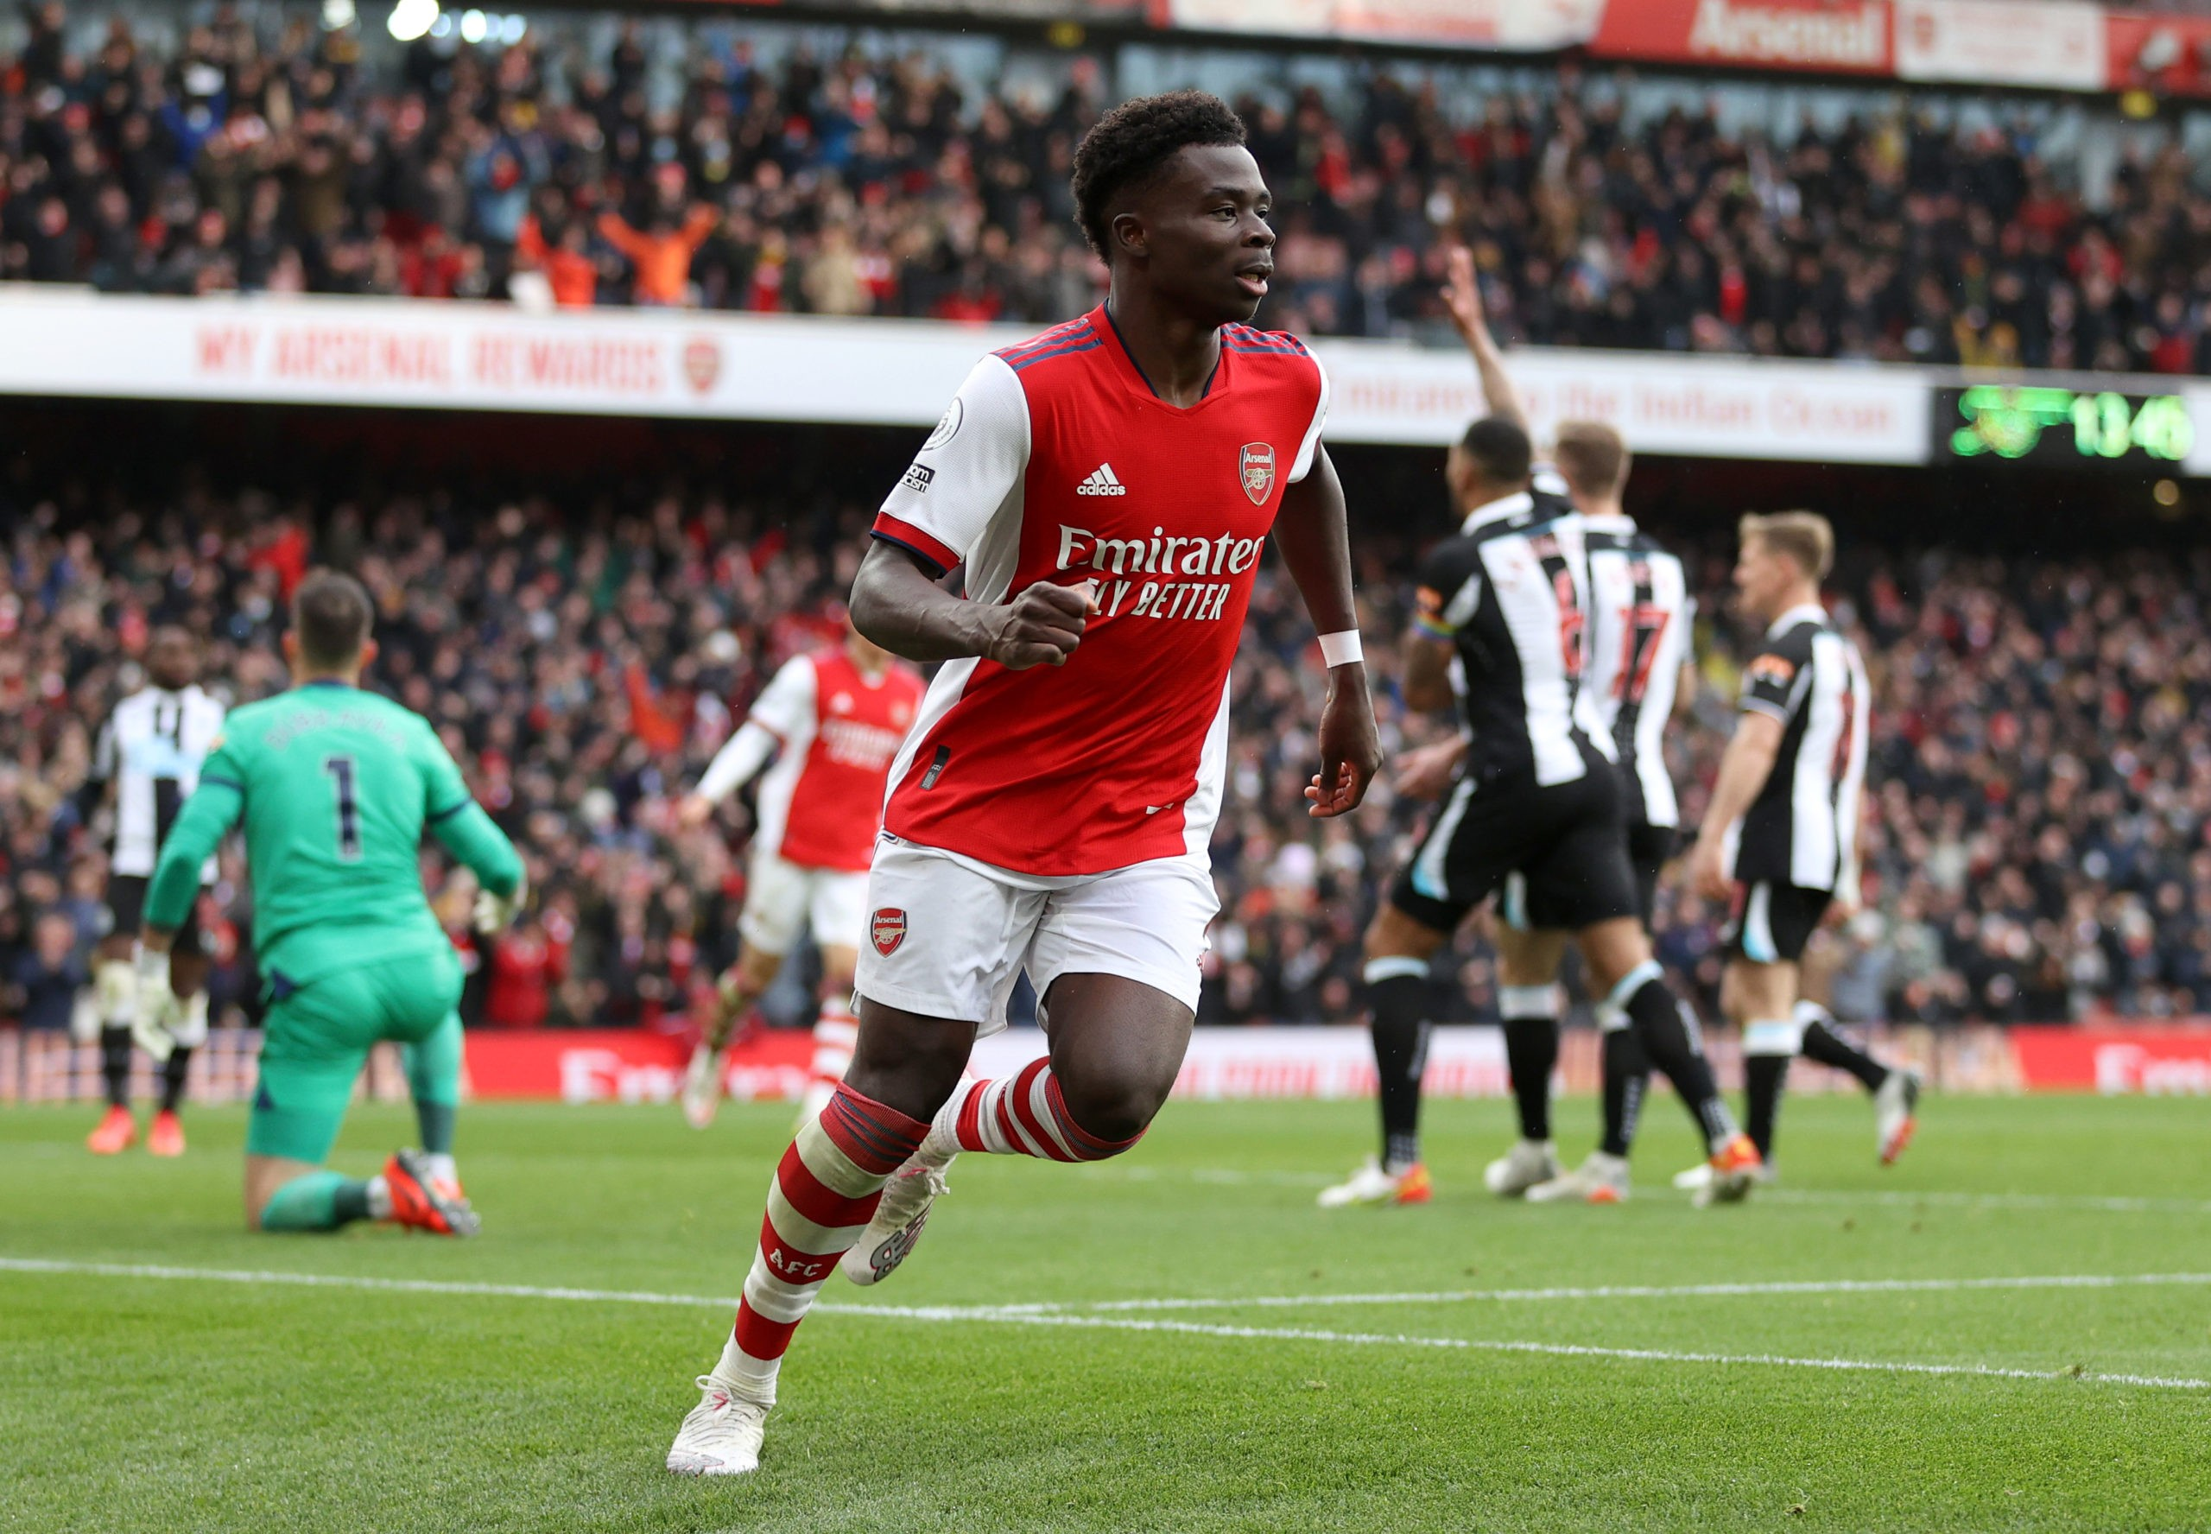
Bukayo Saka

Slide 17
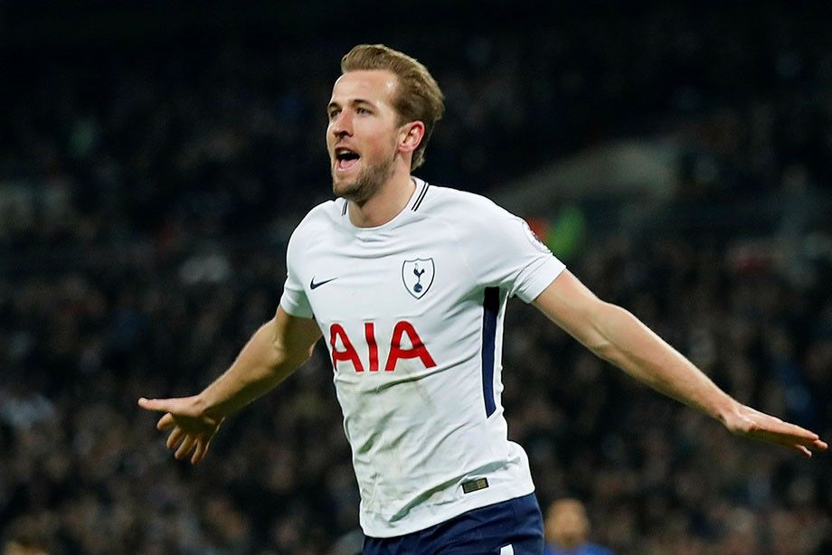
Harry Kane

Slide 18

Aubameyang

Slide 19
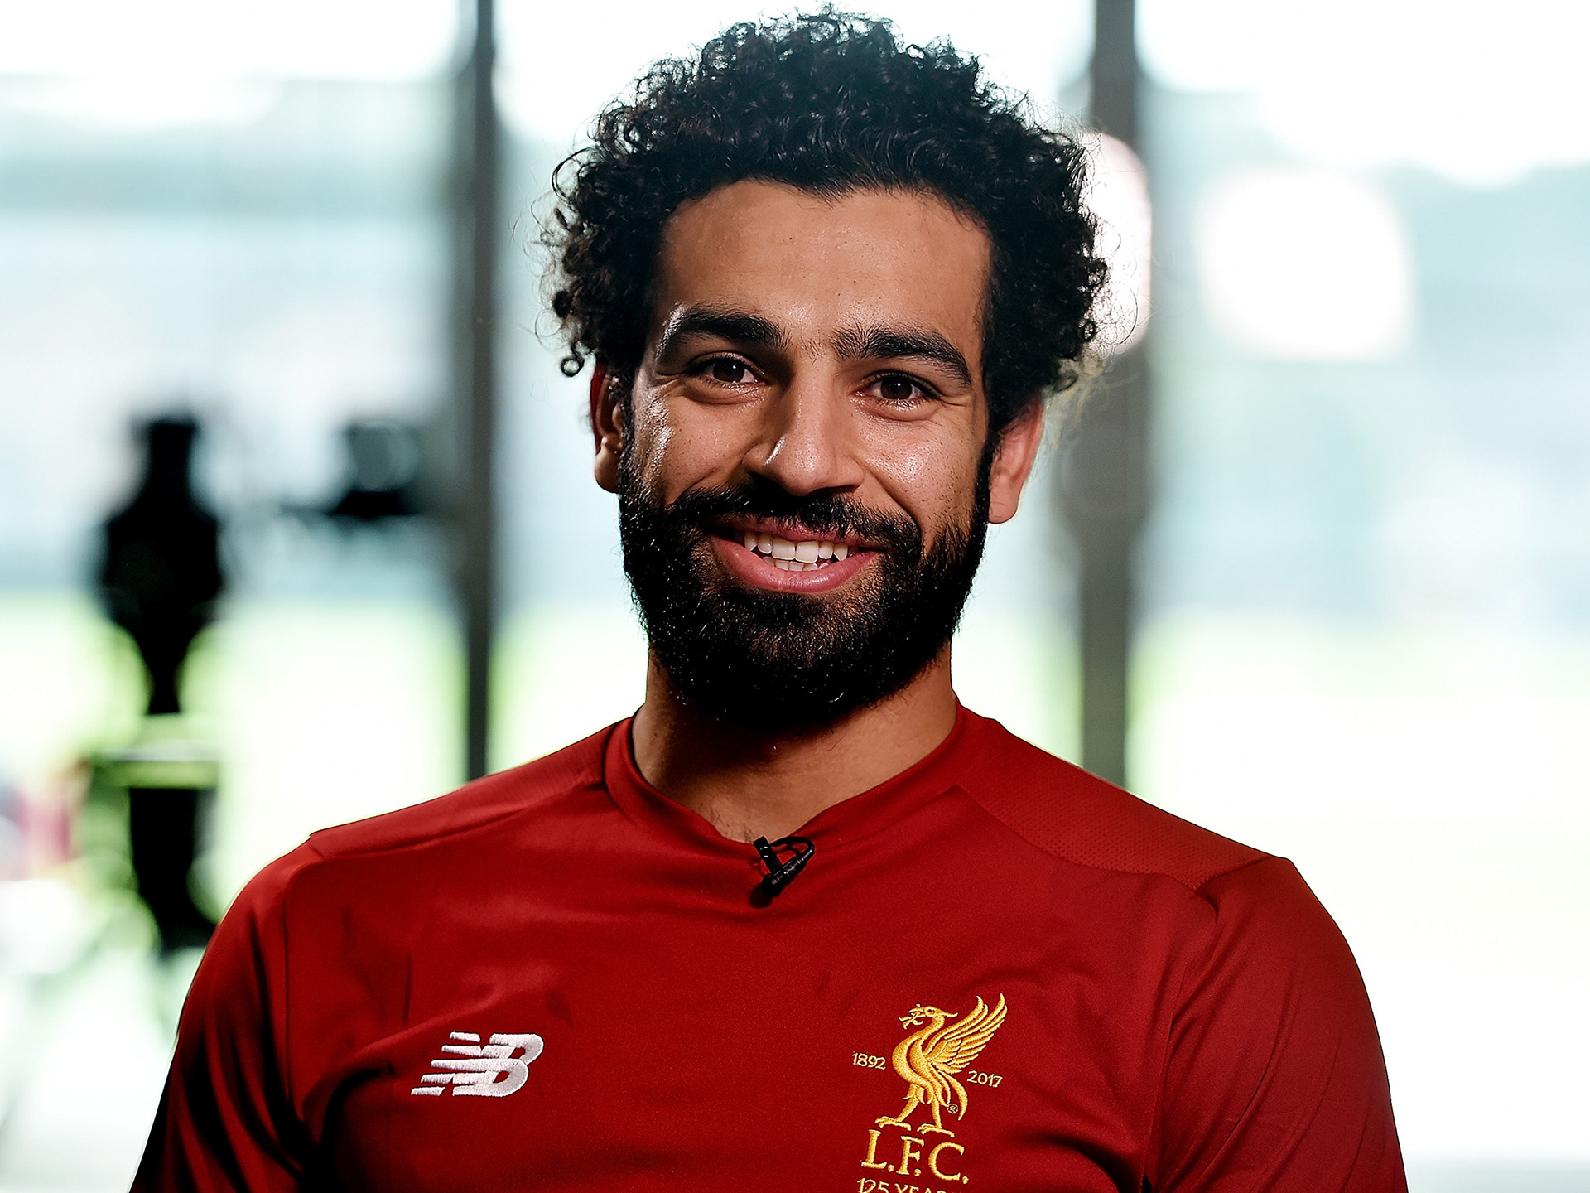
Muhammad Salah

Slide 20

BARELLA

Slide 21

Zlatan Ibrahimovic

Slide 22

Vlahovic

Slide 23

Robert Lewandowskiy

